Slide 1
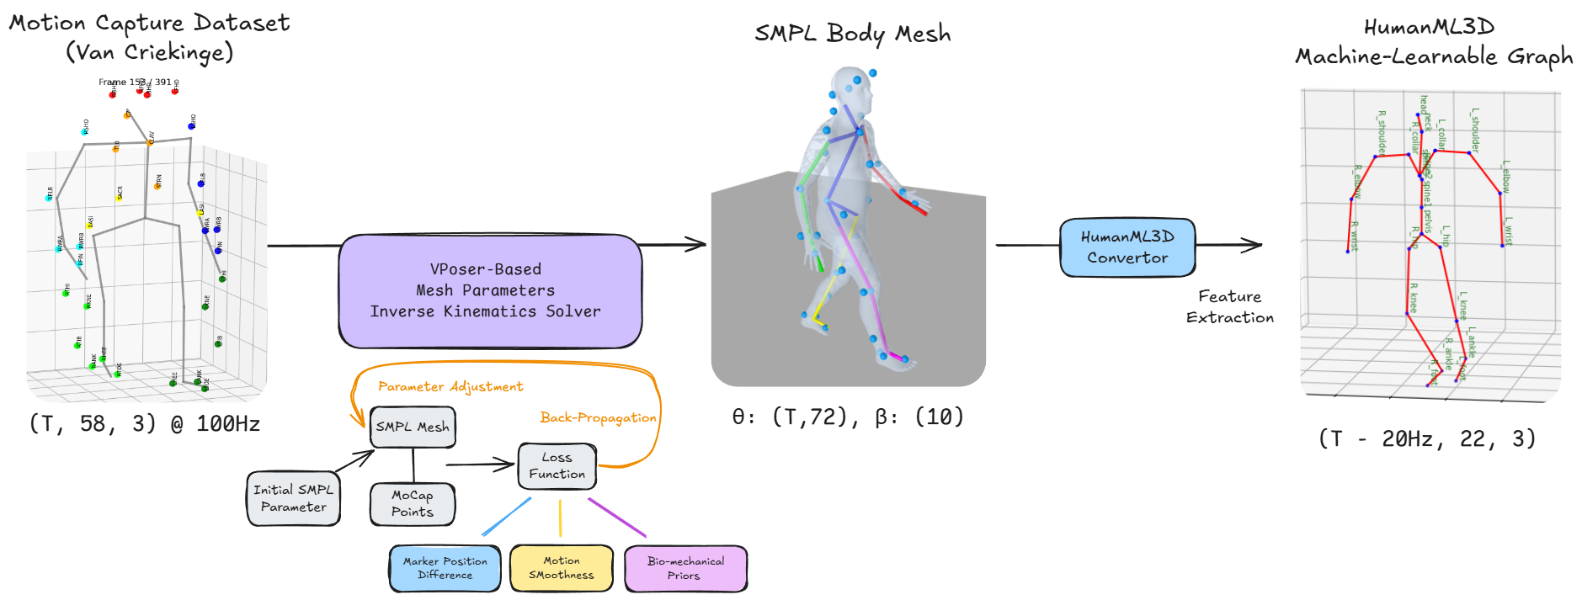
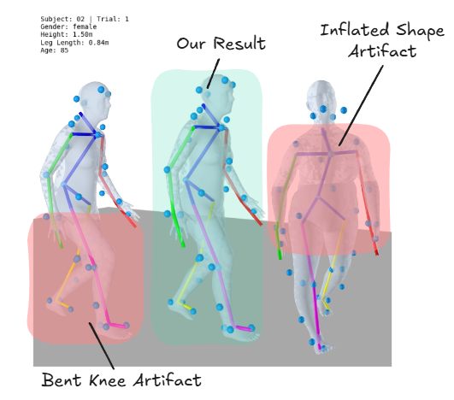
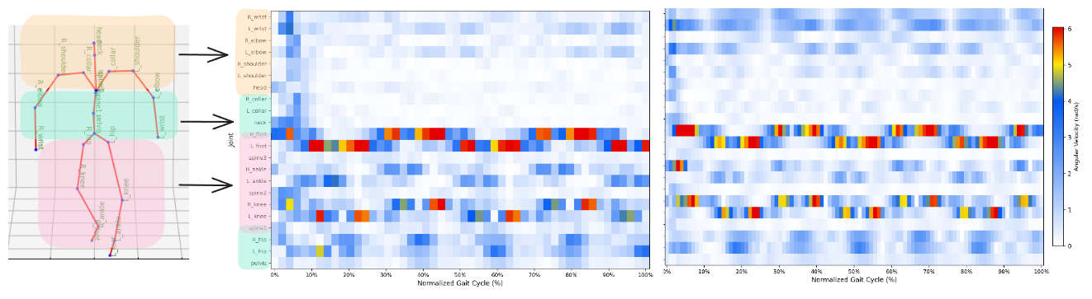
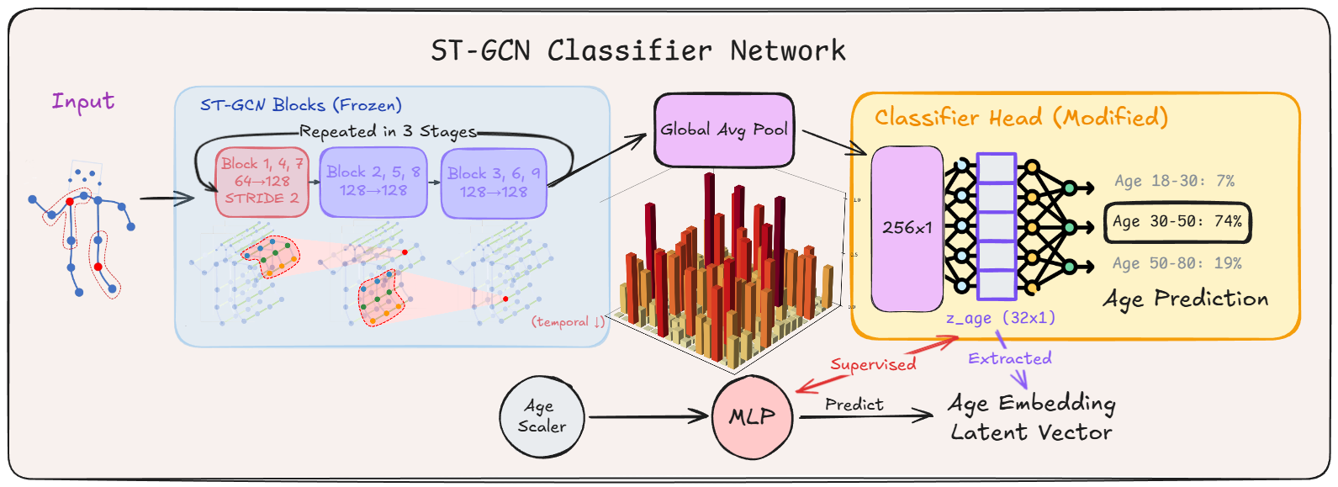
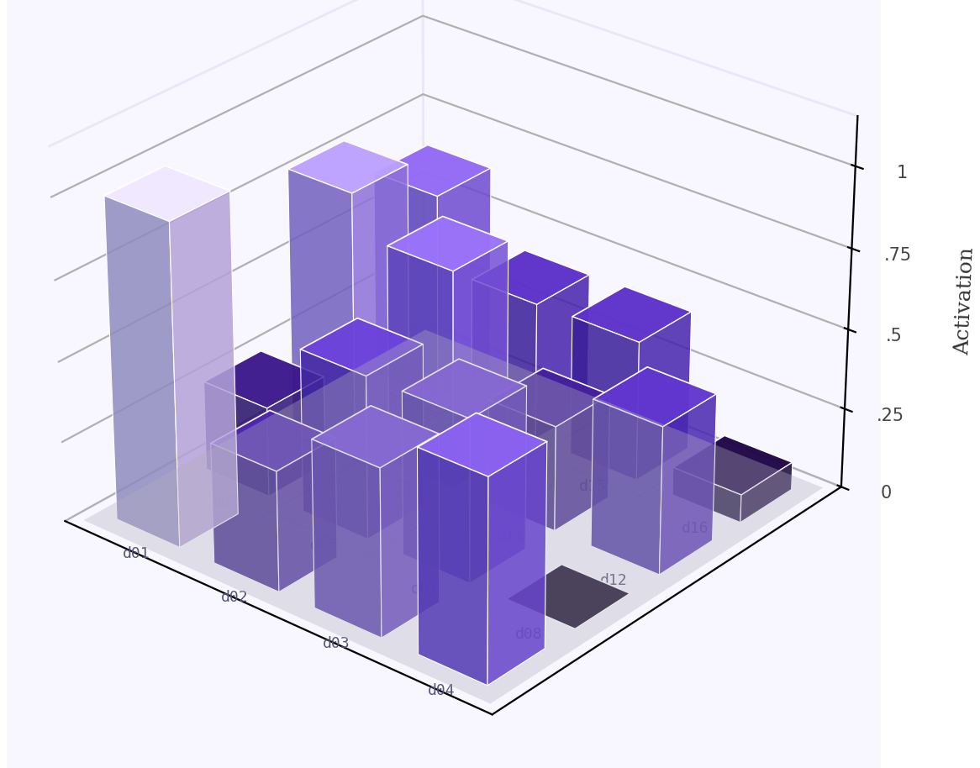
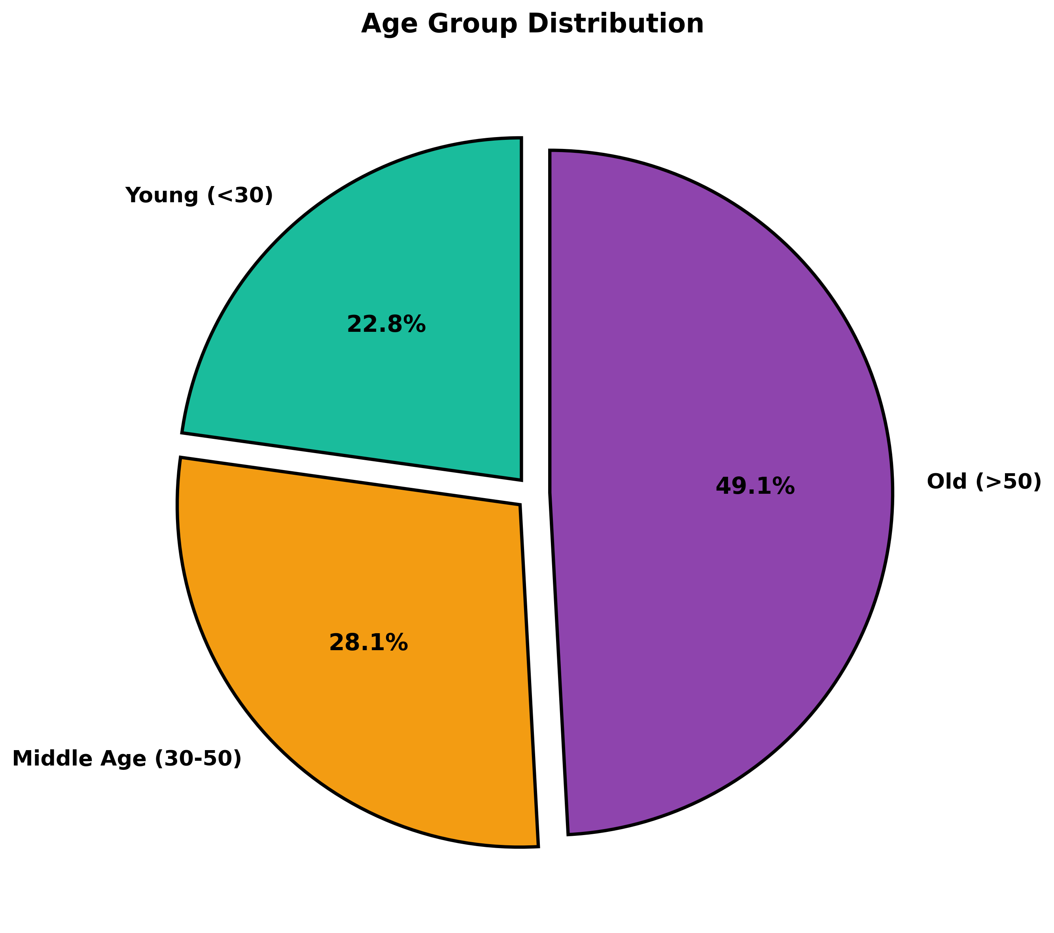
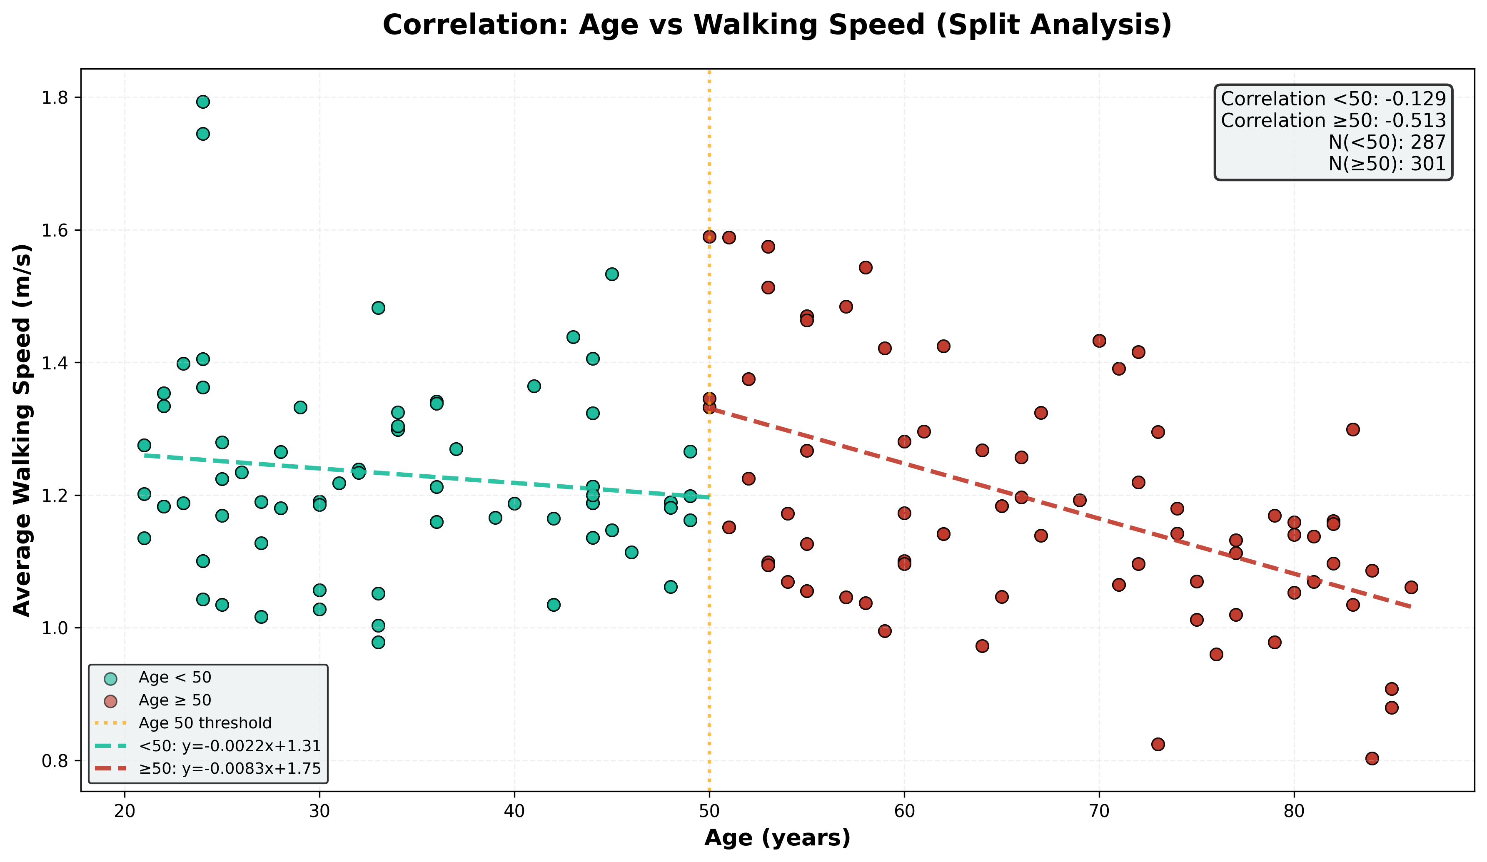
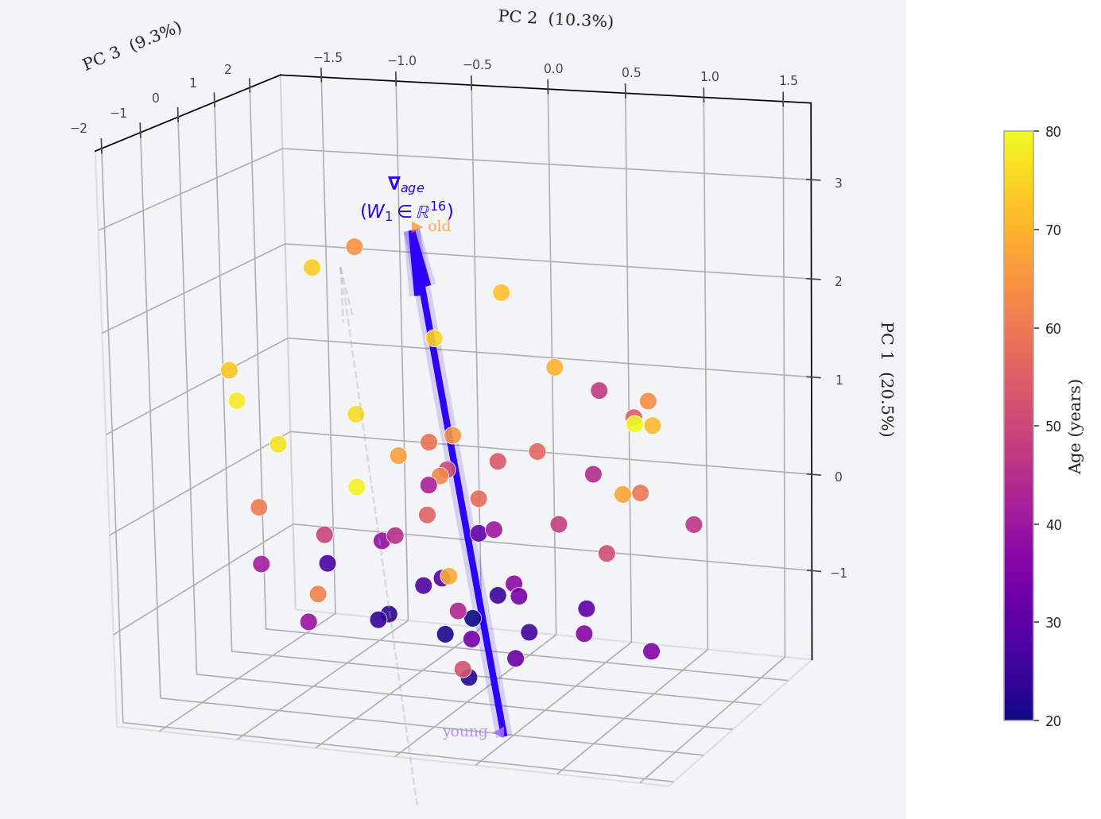
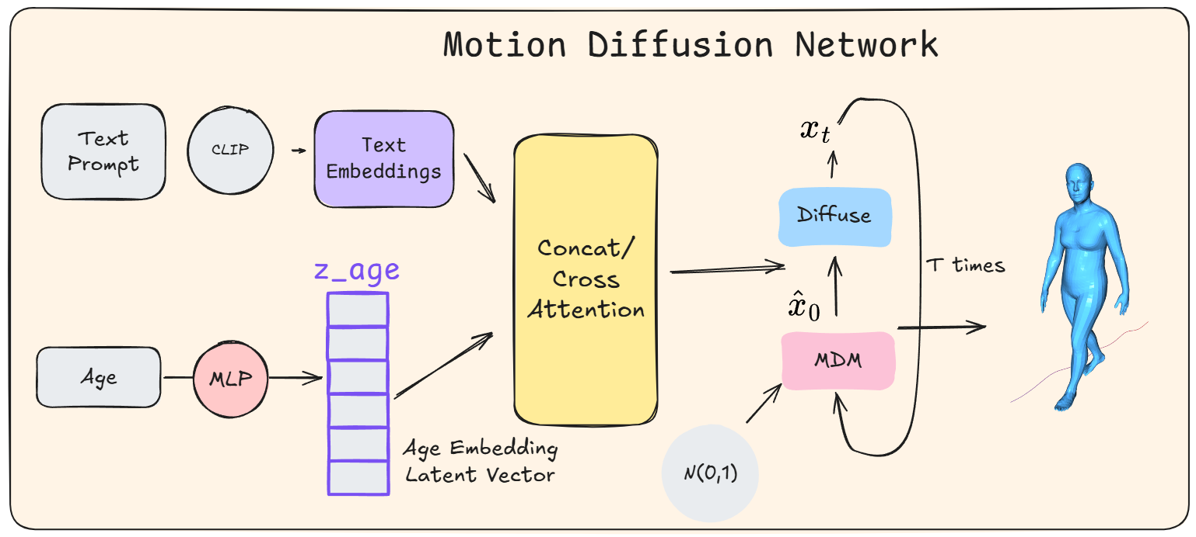
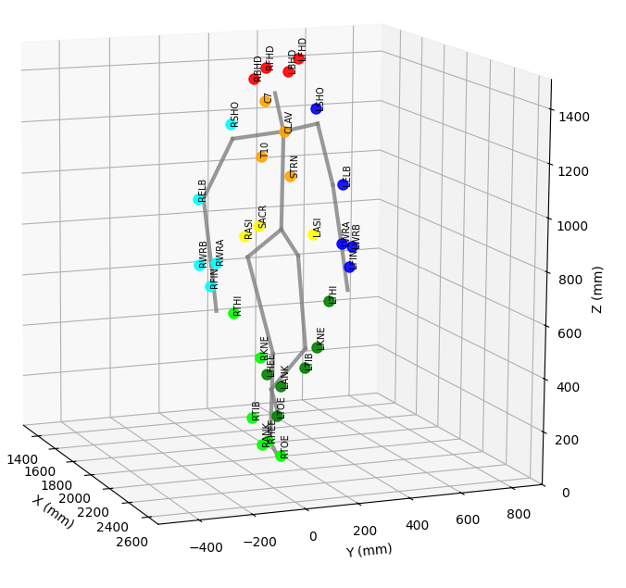
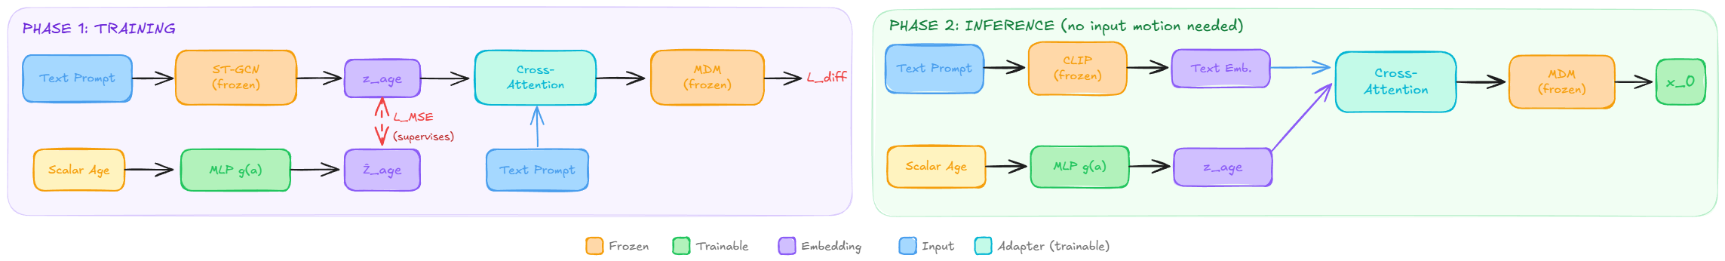
Modeling Kinematic Signatures of Aging via Diffusion and Graph Networks
3DV 2026 Nectar Track
Yiran Liu¹'², Eugene Zhao¹'², Karim Habashy¹'², Jason Peng³, Chang Shu¹, Pengcheng Xi¹
¹National Research Council Canada, ²University of Waterloo, ³Simon Fraser University
Abstract
Data Pipeline
Pipeline Validation
It is well established that aging significantly shapes human movement. Yet existing text-to-motion generative models lack the resolution to reproduce these subtle but clinically meaningful differences. We ask: can data-driven models learn age-related biomechanical variation, and generate motions that faithfully reflect those differences?
We present a three-component framework:
• A pipeline transforming clinical C3D motion-capture recordings into the machine–learnable graph representations (NTU3D and HumanML3D), while preserving age-related kinematic cues. • A Spatio-Temporal Graph Convolutional Network (ST-GCN) detects aging signature and extracts a latent age embedding z-age from skeletal motion sequences.
• This embedding z-age is injected into a text-conditioned Motion Diffusion Model (MDM) via cross-attention, enabling age-conditioned motion generation from natural-language prompt.
⚠
Mesh Inflation
Over-estimated β params → unrealistic proportions
⚠
Crouch Walking
Spurious knee flexion from marker occlusion
✓
Our Pipeline (Vposer-based)
Learned pose prior regularizes solution
Age-discriminative kinematic signals are preserved after conversion — confirming pipeline fidelity. Joint angular velocity (rad/s) across a normalized gait cycle. Elderly subjects (Age 78) show systematically reduced peak velocities and constrained range of motion versus young subjects (Age 24).
Clinical marker data are converted into a machine-learnable graph format through Vertex-based skin mapping, model fitting and feature extraction and model fitting, with noise removal and temporal smoothing to preserve motion quality.
Age 24 (Young)
Age 78 (Elderly)
• Higher peak velocities • Standard gait pattern
• Reduced peak velocity • Lower amplitude across joints
Model Architecture
A Spatio-Temporal Graph Convolutional Network trained to discriminate between three age groups: Young (<30), Mid-age (30–60), and Elderly (>60) from skeleton motion.
The backbone is initialized from weights pretrained on NTU RGB+D, while the modified classifier head is retrained on Van Criekinge data.
A compact classification head (256→32→3) produces age-group predictions; the 32-dimensional penultimate layer serves as z_age — a biomechanically-grounded latent encoding of gait age
Dataset: Van Criekinge
Discussion & Future Work
58
Data Points
138 Subjects
21–86 Age Range
100Hz Capture
588 Trials
Limitations:
• Small and imbalanced dataset: 138 subjects with skewed age-group distribution. • Training Pipeline in refinement: trained ST-GCN classifier model shows moderate-low accuracy and is being improved.
Future Directions:
• Complete the generation loop: Integrate trained z_age embeddings into the LoRA-MDM cross-attention pipeline • Age-specific evaluation protocol: Develop metrics grounded in clinical gait analysis to measure biomechanical plausibility across age groups beyond FID.
Figure: A single 16-dim latent embedding vector z_age, extract from skeleton motion, visualized as 4x4 grid.
Figure: PCA of z_age embeddings (60 subjects, ages 20–80) reveals moderate-weak age-correlated structure in the current latent space, indicating the classifier has not yet learned age-discriminative representations.
This motivates refinement in model architecture and retraining with larger, more balanced and action-rich dataset.
The diffusion model follows the Human Motion Diffusion Model (MDM) architecture. The forward diffusion process is:
Age vs. Walking Speed Correlation
$$q\left(x_{t} | x_{0}\right)=𝒩\left(x_{t};\sqrt{{\overline{α}}_{t}}x_{0},\left(1−{\overline{α}}_{t}\right)I\right)$$
Under 50: r = −0.13 (negligible correlation) Over 50: r = −0.51 (pronounced decline emerges)
where x_{t} ∈ ℝ^{B × T × 263} is the noisy motion sequence. Age conditioning is injected by concatenating z_{age} with the text embedding in the cross-attention layers of the denoising transformer. The training objective minimizes the simple noise-prediction loss:
Acknowledgments
Reduced is one of the primary kinematic signatures of age. While plain walking speed accounts for 50% correlation in aging, discrete latent embeddings from ST-GCN capture structural gait differences — posture, coordination, and joint dynamics.
$$ℒ=𝔼_{𝕩_{𝟘},ε,𝕥}\left[\left.|ε−ε_{θ}\left(x_{t},t,z_{\text{text}},z_{\text{age}}\right)\right.|^{2}\right]$$
This work was conducted at the National Research Council of Canada (NRC) under the Aging in Place (AIP) challenge program. Compute resources was provided by the NRC Trixie HPU cluster. The authors thank Dr. Pengcheng Xi and Dr. Chang Shu for supervision and guidance.
Figure: During inference, no input motion clip is required. The scalar age is mapped to z_age by the trained MLP alone, enabling generation from text prompt and age without real reference motion.
Key references:
[1] Guo et al. — Generating Diverse and Natural 3D Human Motions from Text. CVPR 2022.
Tevet et al. — Human Motion Diffusion Model. ICLR 2023.
[2] Yan et al. — Spatial Temporal Graph Convolutional Networks for Skeleton-Based Action Recognition. AAAI 2018
[3] Van Criekinge et al. — A full-body motion capture gait dataset of 138 able-bodied adults across the life span and 50 stroke survivors.

